Slide 1
Learning to Code Ruby

Slide 2

Your Lead Instructor
Who am I? -- Irina
Picture ☺
I do code
I like wombats
When I grow up, I want to be travelling

Slide 3
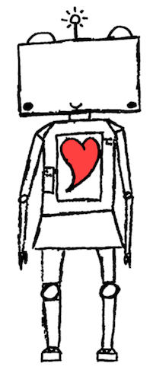
Today’s project
We’re going to teach Ruby Robot to do things

Slide 4
First…
We need to learn how to talk to computers

Slide 5
Getting Started
Open a web browser
Go to http://c9.io
Login as caitlin@ladieslearningcode.com
Password: Helloworld123

Slide 6
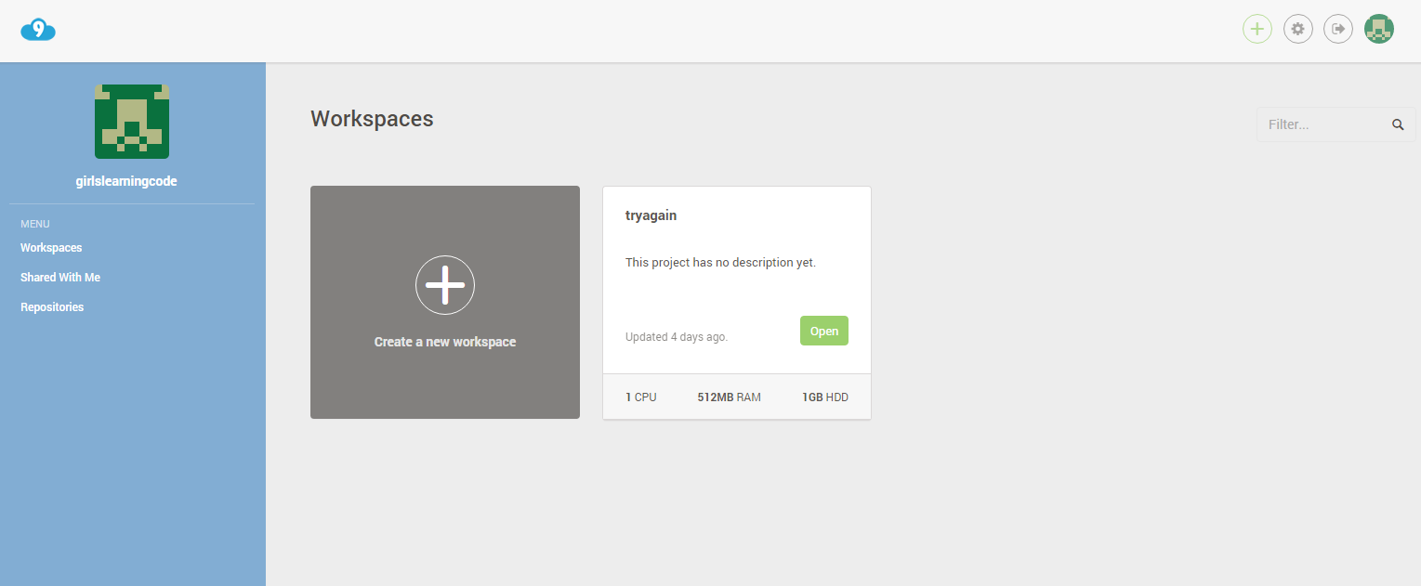

Slide 7
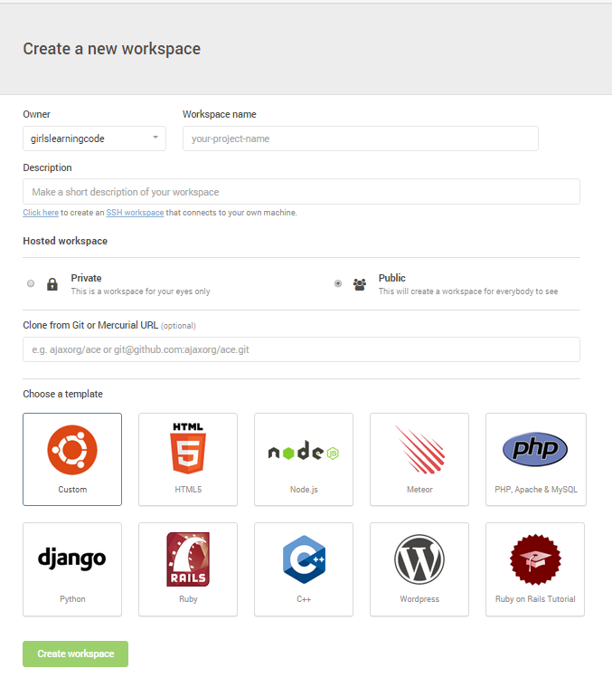
Your Name

Slide 8
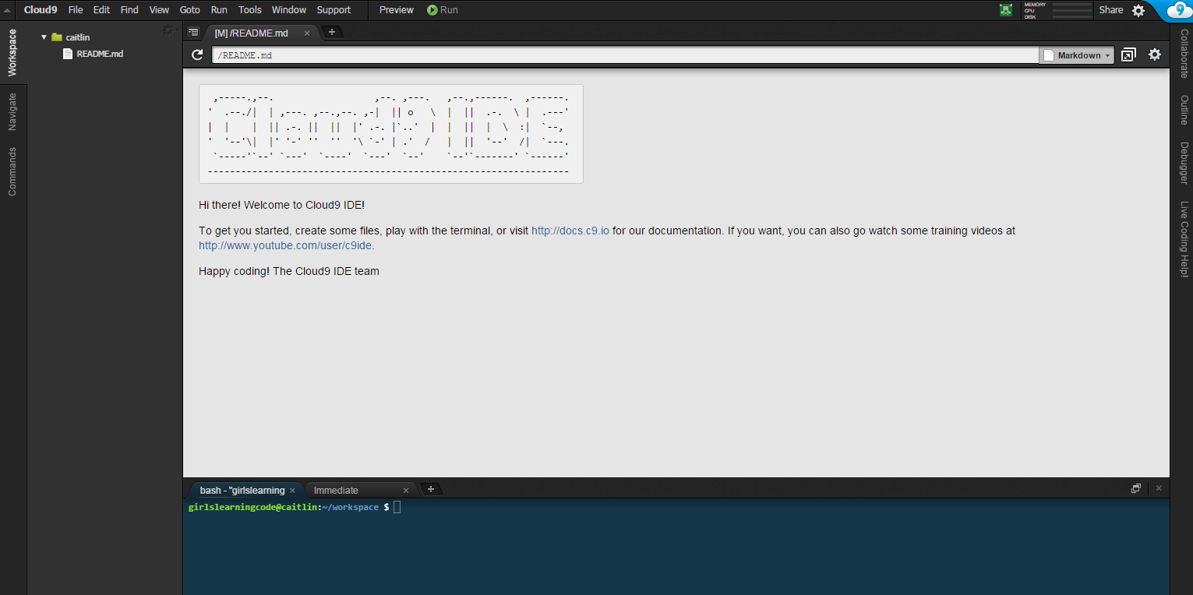

Slide 9
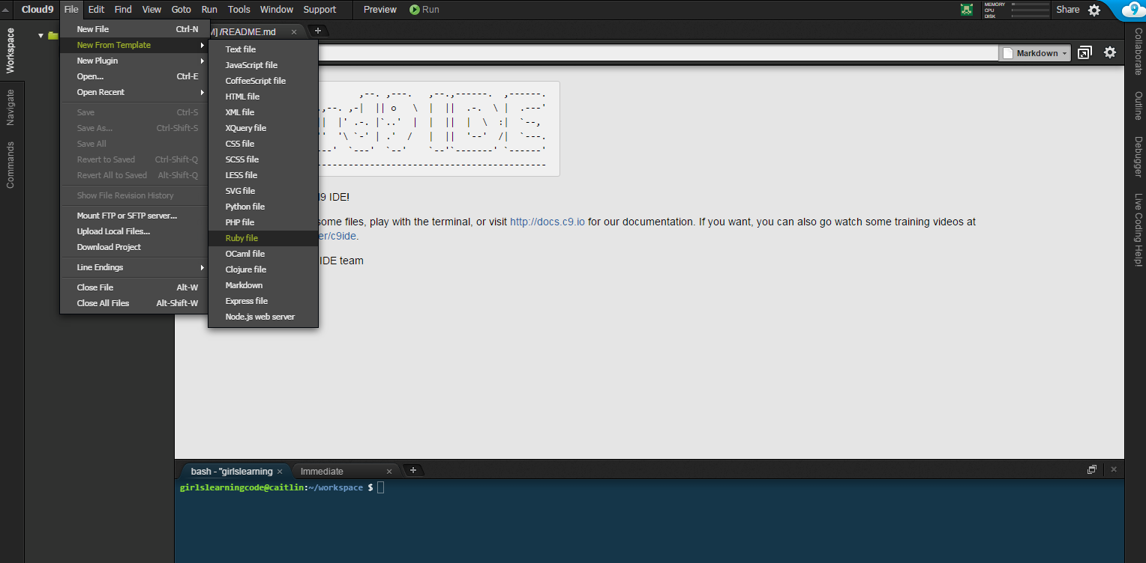

Slide 10
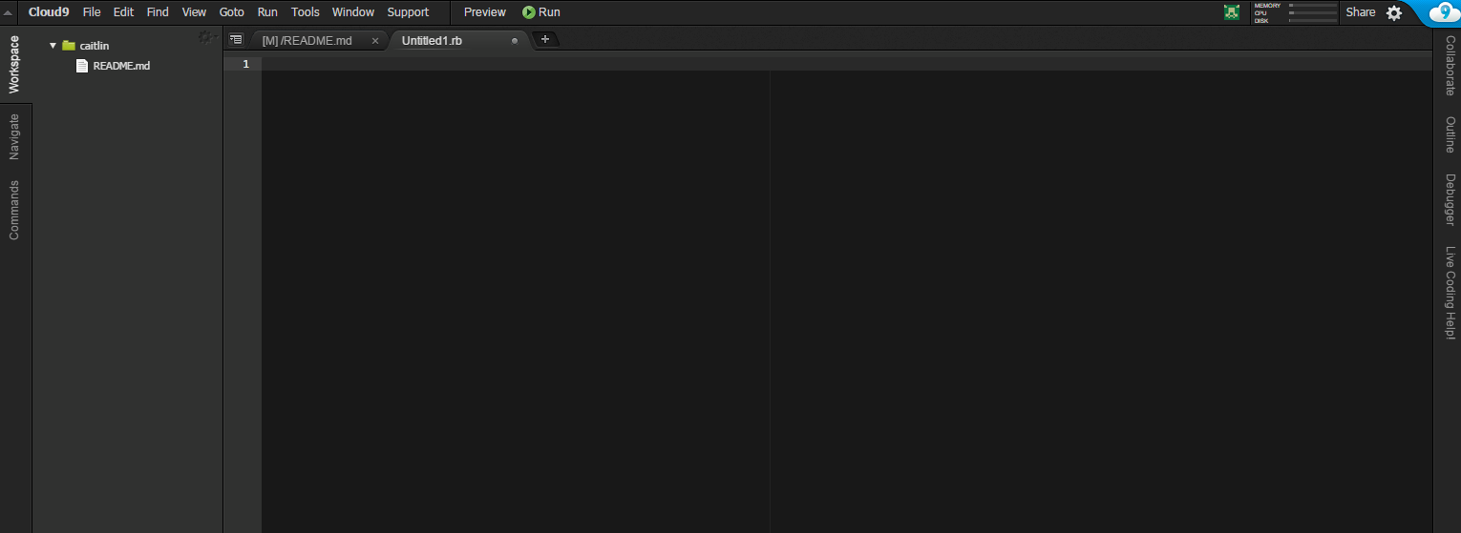

Slide 11
Let’s Get Ruby to do Something

Slide 12
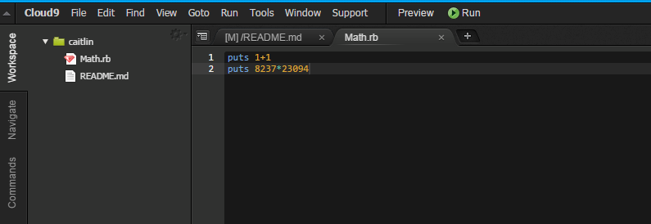
Our Math Homework

Slide 13
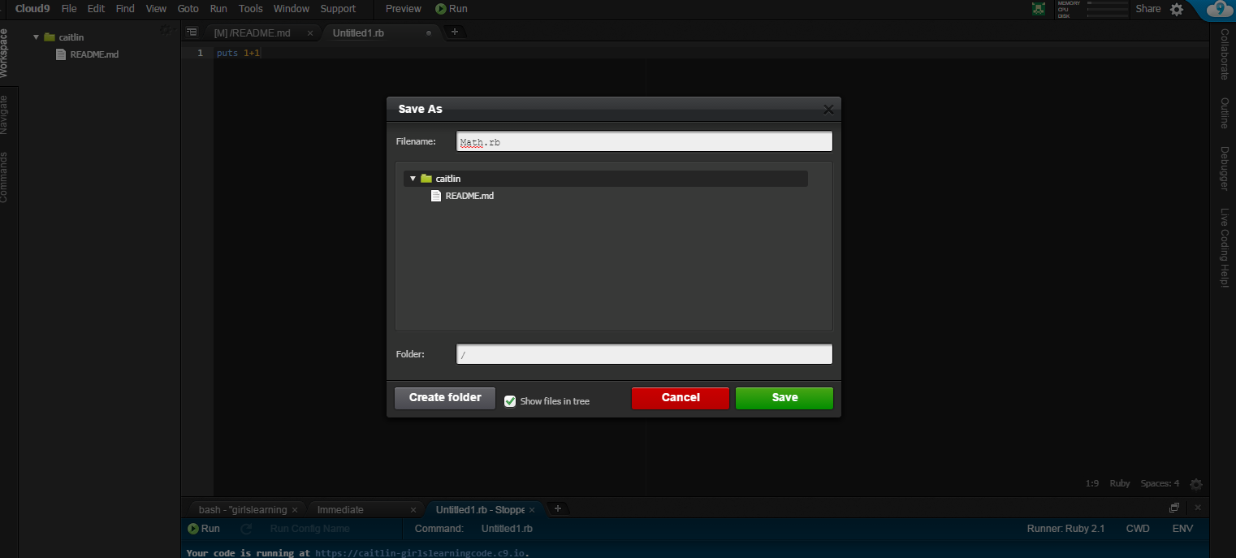

Slide 14
What would happen if we added words together?

Slide 15
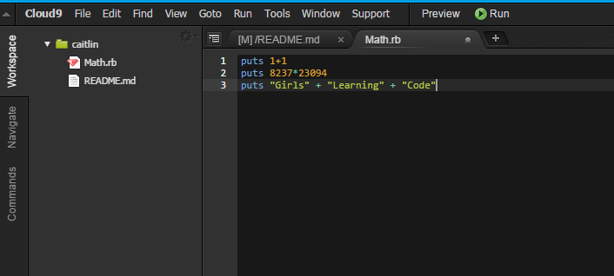
Ruby knows the difference

Slide 16
Spend 5 minutes adding things together

Slide 17
How does Ruby know the difference between words and numbers?

Slide 18
Objects
Just like in our world there are many objects in Ruby Robot’s world
Every object has a barcode
Ruby Robot scans the barcode to find out what type of object it is

Slide 19
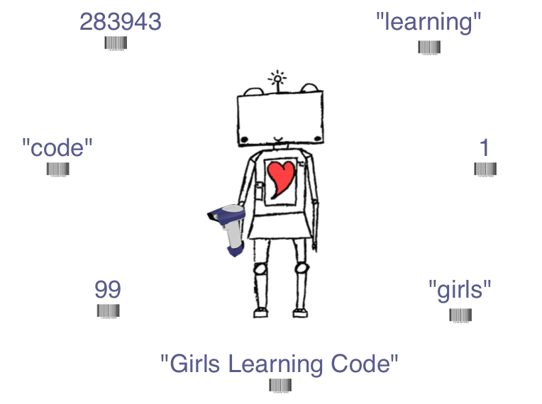

Slide 20
Numbers and Words
In Ruby’s world…
Numbers are called “Integers”
Words are called “Strings”

Slide 21
Ruby’s Book of Instructions
Ruby has a big book of instructions
Each page tells Ruby what to do with different Objects

Slide 22
For Example
When you ask Ruby what 1 + 1 is
Ruby looks through the book of instructions for the class “Integer” and finds what to do with a “+”

Slide 23
Integer
+ means Add
- means Subtract
* means Multiply

Slide 24
String
+ means Make into one String

Slide 25
Playing with Integers
See what happens when you put
puts 99.next

Slide 26
More Fun with Integers
##.round (ex: 1.2.round)
##.to_s (ex: -2.to_s)
##.zero? (ex: 0.0.zero?)
##.numerator (ex: 1.75.numerator)
##.denominator (ex: 1.75.denominator)

Slide 27
Playing with Strings
See what happens when you put
puts “girlslearningcode”.capitalize
puts “girlslearningcode”.upcase
puts “girlslearningcode”.reverse

Slide 28
More Fun with Strings
“string”.chop
“string”*4
“stRINg”.downcase
“string”.empty?
“string”.include? “ring”
“a”.next
“girlslearningcode”.delete “aeiou”

Slide 29
Ruby’s Book of Instructions
The pages in Ruby’s Instruction Book tell Ruby Robot what she can do with each type of Object
The things she can do are the methods

Slide 30
I’m Lazy
All this typing is hard
I don’t want to type “string” all the time
We can store “string” in a shorter format using a variable
If you use: glc = “girlslearningcode”
We can now use: glc.chop or glc*4

Slide 31
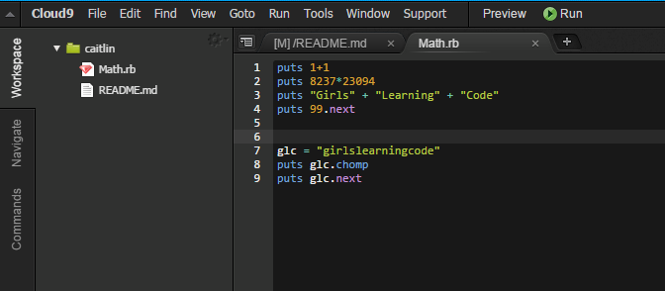

Slide 32
Changing Variables
What if I now want glc to be “girls learning super code”
Or… an Integer; the number 99

Slide 33
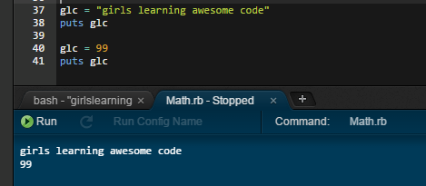

Slide 34
New Variable
What if I want a new variable to be the same as glc?
new_variable = glc

Slide 35
Skill Testing Questions

Slide 36
What would Ruby say?
lisa = “Lisa Simpson”
puts lisa.length

Slide 37
What would Ruby say?
bart = “Bart” + “Simpson”
puts bart

Slide 38
What would Ruby say?
lisa = “Lisa Simpson”
bart = “Bart” + “Simpson”
puts lisa + bart

Slide 39
What would Ruby say?
lisa = “Lisa Simpson”
bart = “Bart” + “Simpson”
puts lisa + bart.reverse

Slide 40
What would Ruby say?
lisa = “Lisa Simpson”
bart = “Bart” + “Simpson”
puts lisa.upcase

Slide 41
What would Ruby say?
lisa = “Lisa Simpson”
bart = “Bart” + “Simpson”
cartoon = lisa
puts cartoon

Slide 42
What would Ruby say?
lisa = “Lisa Simpson”
bart = “Bart” + “Simpson”
cartoon = lisa
cartoon = bart
puts cartoon

Slide 43
Getting Input from the User
So far the computer has just been telling us stuff. How do we talk to the computer?
gets

Slide 44
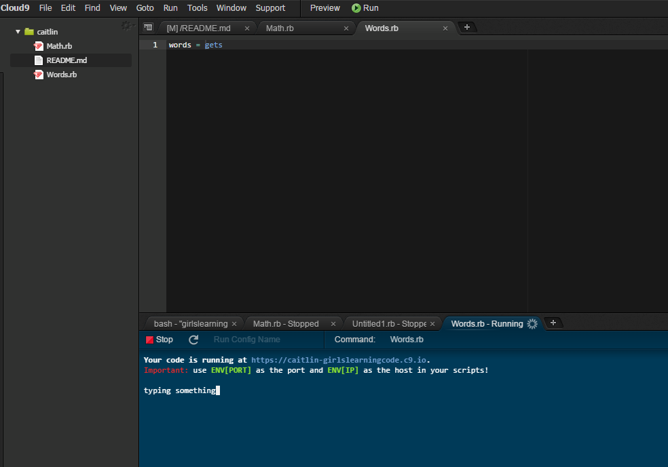
Try it
Open a new Ruby file
words = gets
Then Run

Slide 45
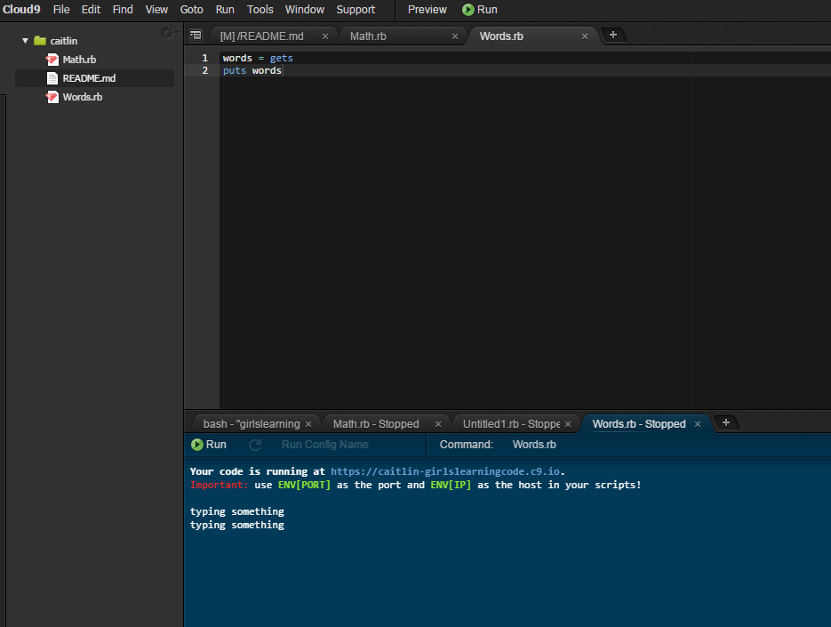
Hmm… How do I know it worked?
words = gets
puts words

Slide 46
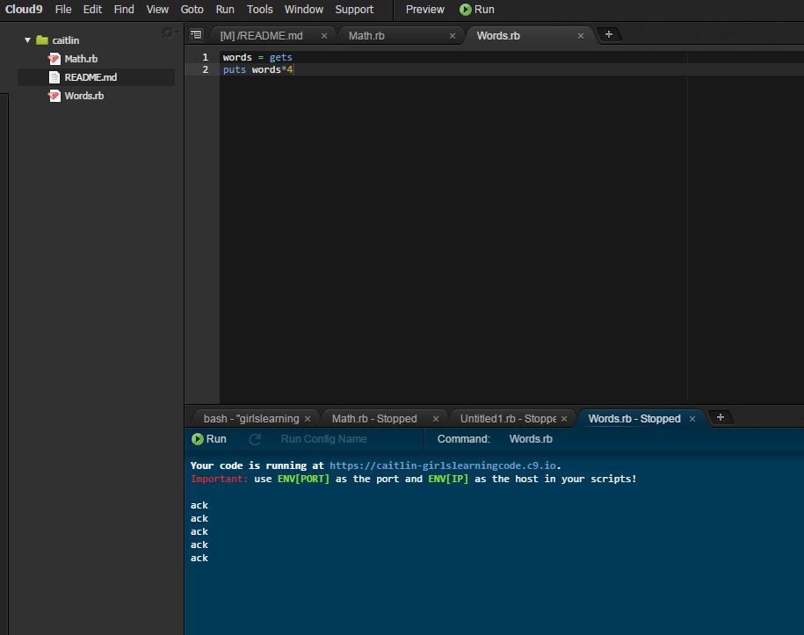

Slide 47
Asking for Input
When you press “enter” after you type something Ruby hears that as part of your words and stores it
We don’t want that to happen so we will use the .chomp from before to remove it

Slide 48
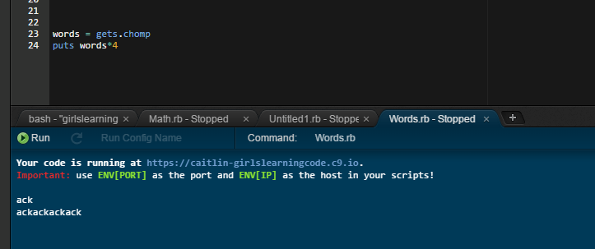

Slide 49
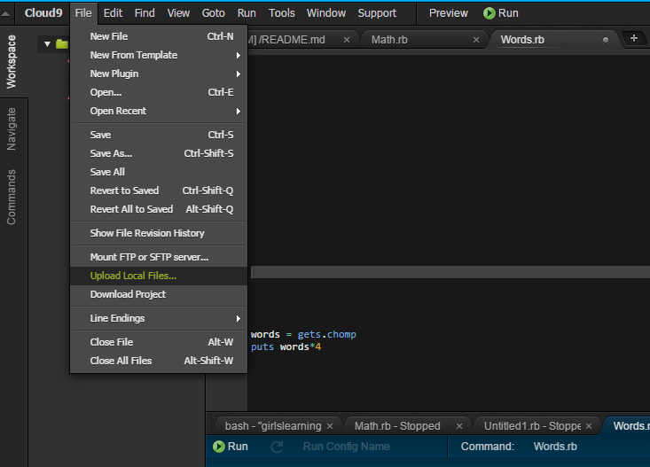
Let’s Load a File

Slide 50
Run Greeting.rb
What does it do?

Slide 51
Mad Libs
Warning! English Content!
Verb = Action
Adjective = Describing Word
Noun = Person Place or Thing
Plural = More Than 1
Adverb = Modifier of a Verb (usually ends in ly)

Slide 52
10 Minutes
Run madlib1.rb
And madlib2.rb

Slide 53
Create Your Own Mad Lib
Create a new file madlib.rb
Create your own story with inputs from your user

Slide 54
Detour: Looping
What if I wanted to output the same thing 3 times
puts ‘Hello Ruby Robot’
puts ‘Hello Ruby Robot’
puts ‘Hello Ruby Robot’

Slide 55
Detour: Looping
There is an easier way
3.times do
puts “Hello Ruby Robot”
end

Slide 56
Detour: Looping
What would the following do?
6.times do
puts “Hello Ruby Robot”
puts “Hello Caitlin”
end

Slide 57
Detour: Looping
How would I get the computer to ask me how many times it should loop?
And then have it loop that number of times?

Slide 58
Giving Output Based on Input
What if I wanted the computer to ask what my favourite colour was; and if I said “yellow” it would say “oh, that’s my favourite too”?

Slide 59
Logic
Programming is all about writing instructions in a simple way computers can understand
Let’s break down the favourite colour example into simple instructions

Slide 60
Logic
If the favourite colour is “yellow” tell the user “oh, that’s my favourite too”
If the favourite colour is not “yellow” tell the user “um, ok I guess”

Slide 61
Logic Symbols
Equal is ==
Other options…
>=
<=
>
<
!=

Slide 62
Favourite Colour
Ask the user for their favourite colour
If the favourite colour is “yellow” tell the user “oh, that’s my favourite too”
If the favourite colour is not “yellow” tell the user “um, ok I guess”

Slide 63
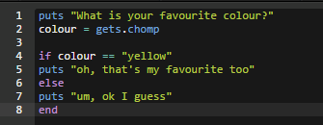

Slide 64
Favourite Colour
What happens if someone enters Yellow?

Slide 65
Better Favourite Colour
Add 3 more responses to different colours
You can use the command elsif

Slide 66
Birthday
Have the program ask for your age
Have the program tell you if you are 16 or older
Have the program tell you how many years until you will be 30

Slide 67
Demo time!
Share with us what you’ve created!

Slide 68
What is an Integer?

Slide 69
What is a String?

Slide 70
What is a Method?

Slide 71
What is a Variable?

Slide 72
How do I store something in a Variable?

Slide 73
variable_name = “something I want to store”

Slide 74
How do I show something to the user?

Slide 75
puts “something I want to print”

Slide 76
How do I get a response from the user?

Slide 77
response = gets.chomp

Slide 78
How do I switch from String to Integer?

Slide 79
“string”.to_i

Slide 80
What about from Integer to String?

Slide 81
239534.to_s

Slide 82
How do I check if 2 things are equal?

Slide 83
“thing one” == “thing two”

Slide 84
What do all “if” statements have to have?

Slide 85
end

Slide 86
What if I’m looking for “yellow” and someone puts in “Yellow”

Slide 87
input = gets.chomp
if input.downcase == “yellow”
do something
end

Slide 88
A twitter program
Ask (politely) for a tweet from the user
Store the tweet in a variable, without \n
Output the tweet the user gave
Output the number of characters in the tweet
Output how many more characters the user can add until they hit 140 characters
puts gets “string”.length “string\n”.chomp

Slide 89
Adding on…
If the user enters a tweet that is more than 140 characters don’t output the tweet; instead tell them their tweet is too long

Slide 90
Loops
puts “Hi!”
greeting = gets.chomp
while greeting != “bye”
puts greeting
greeting = gets.chomp
end

Slide 91
More Loops
3.times do
puts “Hip Hip Hooray!”
sleep 1
end

Slide 92
Even More Loops
puts “On the count of 5…”
[1,2,3,4,5].each do | i |
puts i
sleep 1
end
puts “Go!”

Slide 93
Counting Down in a Loop
99.downto(1).each do | i |
puts “#{ i } bottles of soda on the wall…”
sleep 0.5
end

Slide 94
#{my_variable}
How did we use an integer in a String without using the .to_s we used yesterday?
You can use this inside of a string and Ruby will treat the variable exactly like a String

Slide 95
Escaping a Loop
What if we want to leave a loop early?
We can use the command break
Let’s add up a bunch of numbers and when we get to 20 stop

Slide 96
Leave when we get to 20
sum = 0
[1,3,6,8,3,6].each do | i |
sleep 1
puts “Adding #{ i } to our sum”
if sum >= 20
puts “we’re done”
break
end

Slide 97
Array
Arrays store information in sequence
[12, 25, 93]
[“girls”, “learning”, “code”]
What happens if we try to create an array with numbers and words?
bob = [“girls”, 123, “sally”]

Slide 98
Methods of Arrays
numbers = [4, 25, 234, 1, 4, 7]
puts numbers.max
puts numbers.sort
puts numbers.join(‘, ‘)
puts numbers[1]
puts numbers.uniq
puts numbers.delete_at(0)
numbers << 13
puts numbers

Slide 99
Favourite Colour Revisited
Loop through a list of colours
For each colour, ask the user if it is their favourite
If the user types yes, set the favourite_colour variable to that colour and stop asking
If the user types anything else keep going
Once you have gone through all the colours print the user their favourite colour. If they never said yes, tell them they are too picky.

Slide 100
Let’s Play with Poetry
poem = "This is a poem \n this is the second line of the poem \n and the third line“
puts poem

Slide 101
That’s a Boring Poem
Add this line:
poem[‘poem’] = ‘dinosaur’

Slide 102
What happens if we reverse?
poem.reverse

Slide 103
Whoops
I wanted to reverse the order of the lines; not all the letters
poem.lines.to_a.reverse
instead of lines we can also use bytes or chars

Slide 104
It still doesn’t look right
Try
poem.lines.to_a.reverse.join

Slide 105
Compliment Engine
Our user is having a bad day; let’s build a compliment engine to brighten their mood
First, we’ll need a list of compliments where can we store those?
We’ll have 2 lists; one of adjectives (great, wonderful) and one of activities (swimming, riding a bike, reading)

Slide 106
Compliment Engine
Ask for the Person’s Name
Print “Here is your compliment Name”
Print a compliment
ex: Name you are [adjective] at [activity]

Slide 107
Endless Compliment Engine
What if we wanted the compliments to keep on going until the person said stop?

Slide 108
Endless Compliment Engine
Ask for the Person’s Name
Show them a menu of options “c = compliment; q = quit”
If they say Yes - Print “Here is your compliment Name” and print a compliment
ex: Name you are [adjective] at [activity]
If they say No – Say “Goodbye”
If they say something else – Say “Please enter either Yes or No”
Print a compliment
ex: Name you are [adjective] at [activity]

Slide 109
Great!
But… what if your user can’t ride a bike?
Let’s make the list of hobbies updatable

Slide 110
Updating Activities
After we ask for their name
Ask them what activities they like 5 times
Add their answers to our list of potential activities

Slide 111
What other features could we add?

Slide 112
Pet Naming Service
I just got a new tortoise and I don’t know what to name it
Can you build a system to help me?

Slide 113
What Should it Do?

Slide 114
Hash
A hash is where we can store a dictionary
Let’s make a Hash to store very short book reviews

Slide 115
Our rating system
splendid
quite good
mediocre
quite not good
abysmal

Slide 116
Ok let’s get started
books = Hash.new
books[“Cat in the Hat”] = “splendid”
books[“Charlotte’s Web”] = “quite good”
…
puts books[“Cat in the Hat”]

Slide 117
Getting Book Review
Let’s make it so that users can give us a book title and we will tell them what we thought of it
How would we do that?

Slide 118
Other things we can do
puts books.keys

